Slide 1

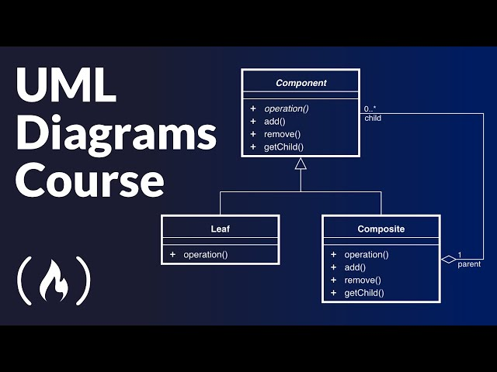

COS 214 Project (Git it done)
Git It Done

Slide 2
Meet the Team:
Joshua Heath
u23541475
Antony Van Straten
u24590739
Avuyile Sapula
u23540282
Hamdaan Mirz
u24631494
Dylan Hebron
U22503685
Abdelrahman Ahmed
U24898008
Abdulrahman Sabah
u24566179

Slide 3

Agenda:
Overview:
Contributions
Assumptions:
Design Patterns With explanation
Bonus mark
Development Practices (github and unit testing)
Conflict
Demo
Any questions ?

Slide 4
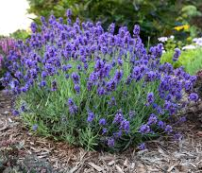
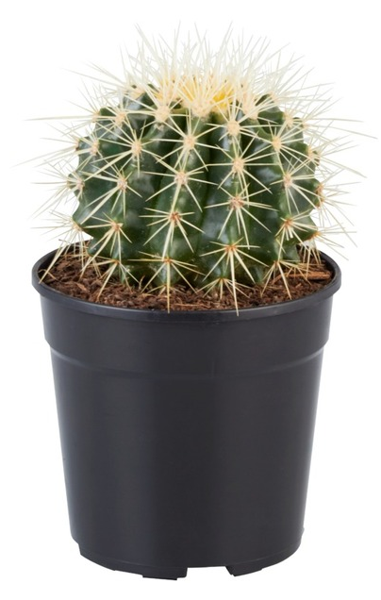

Overview
Customers request plants from cashier
3 Plant Types: Cactus, Lavender, Rose
Each plant uses its own Care Strategy
3 Staff Roles (Chain of Responsibility):
Greenhouse Manager → care strategy
Landscaper → plant states
Delivery Staff → delivery only
6 Plant States: Seedling, Growing, Dormant, Mature, Selling, Dead

Slide 5
Contributions:
GitHub Creation: All
Report: Dyal + Abdul
Presentation : Dyaln + Abdul
Gui: Josh Health
Unit Tests: Hamdaan Mirz
Design Patterns: Each person

Slide 6

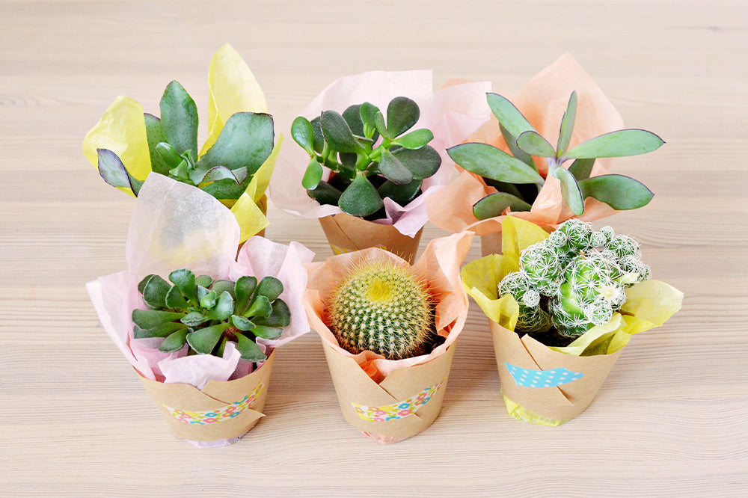
Assumptions:
The inventory will already be filled with plants before the system starts.
Staff members will check plant availability in the inventory before selling to customers.
The Front Desk will handle customer interactions, such as:
checking which plants the customer wants
confirming availability
sending the order to the correct staff member
When a delivery staff member takes plants to a customer:
they will ask the customer about decorations or any custom preferences

Slide 7

What design pattern we used
Prototype
Iterator
Decorator
Factory
Observer
Command
Strategy
State
Chain of responsibility
Bridge
Mediator

Slide 8
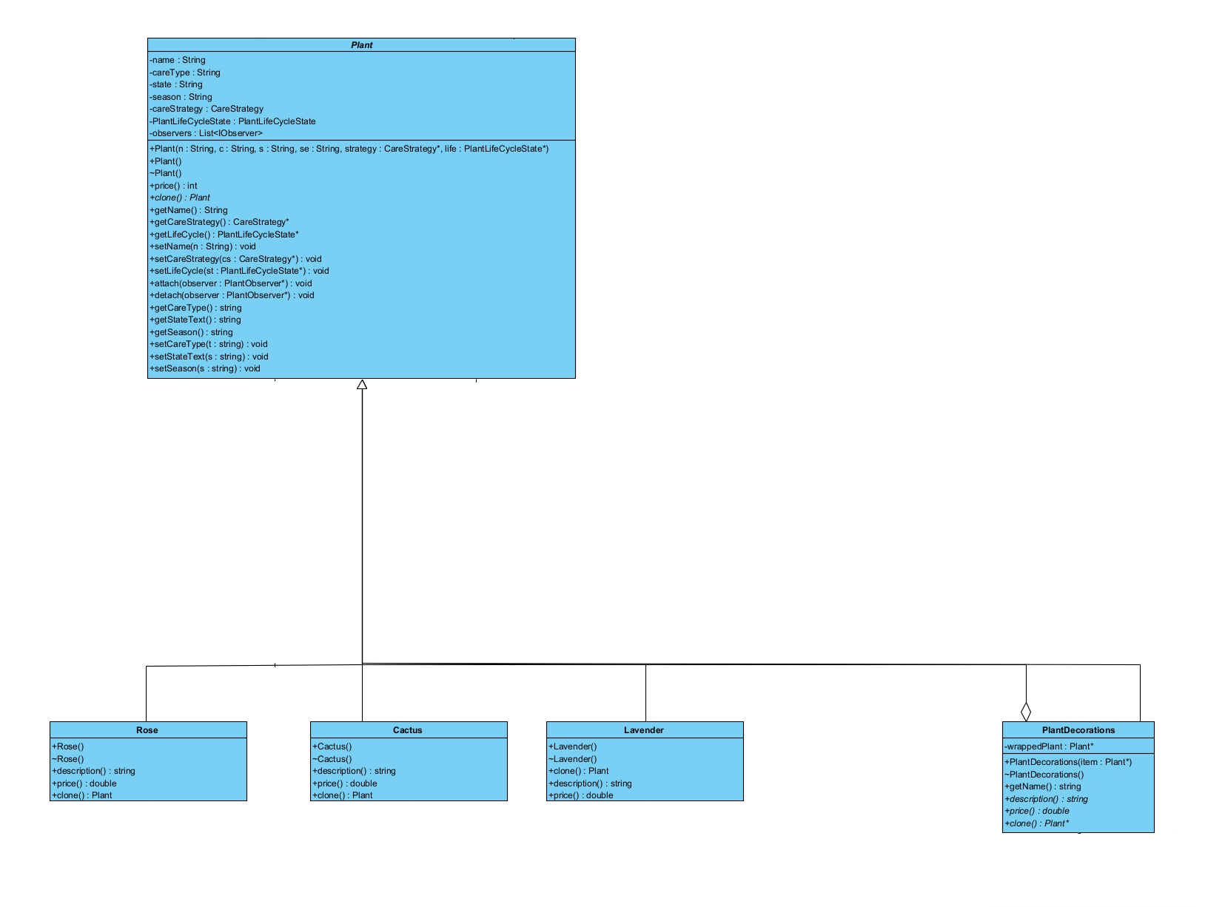
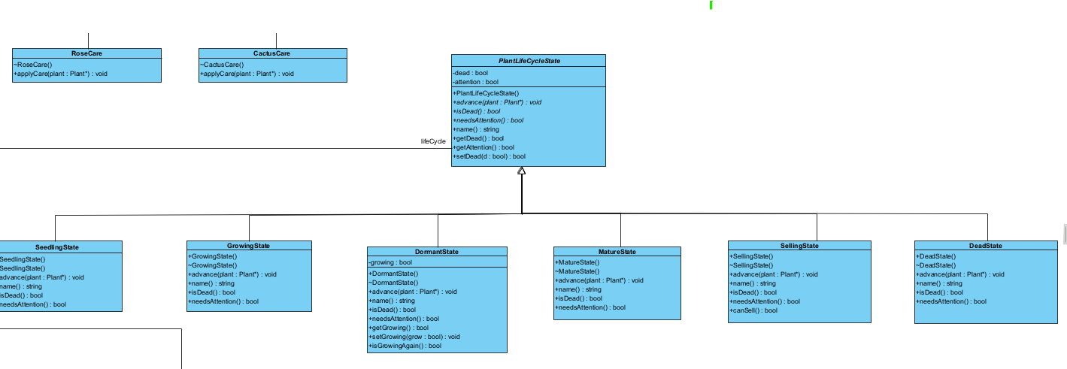
Prototype:
State

Slide 9
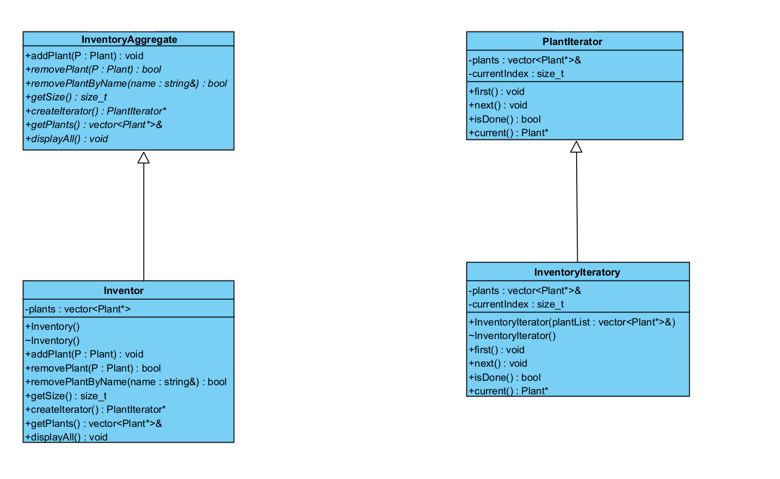
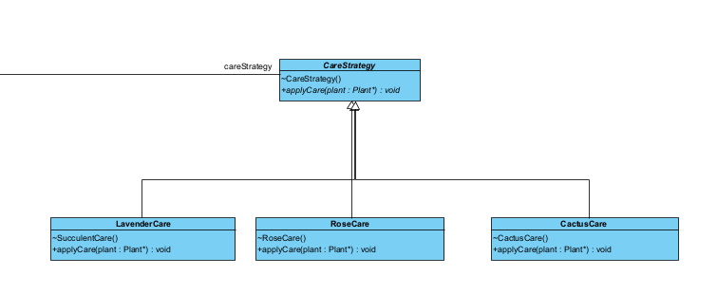
Iterator
Strategy

Slide 10
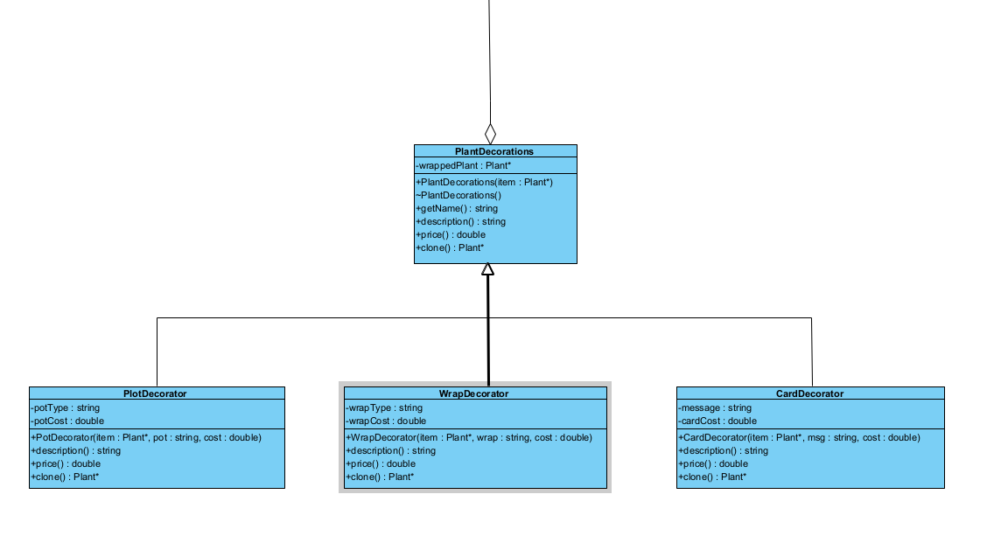
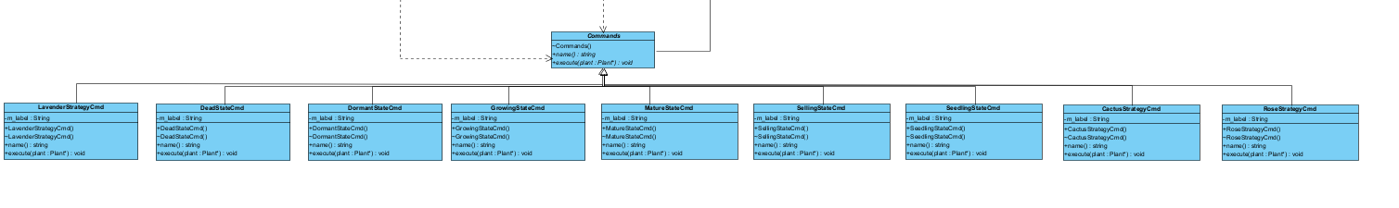
Decorator
Command

Slide 11
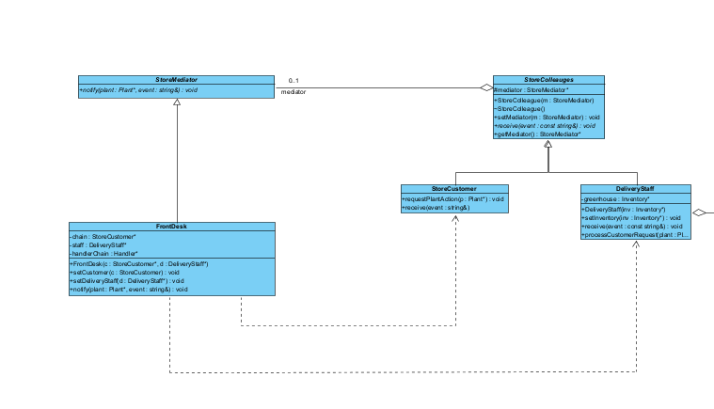
Factory
Mediator

Slide 12
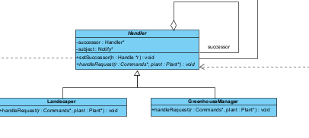
Observer
Chain of responsibility
Need Picture

Slide 13
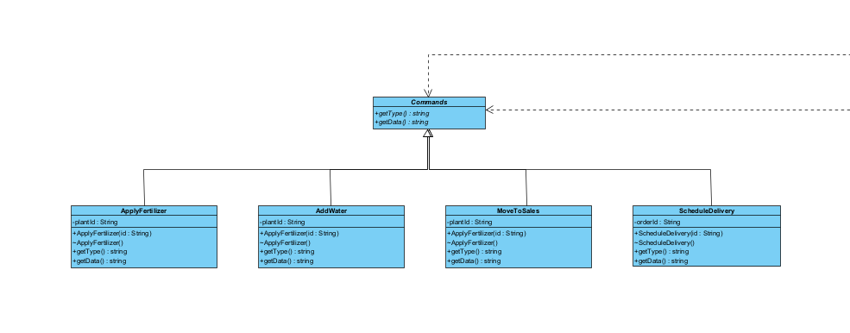
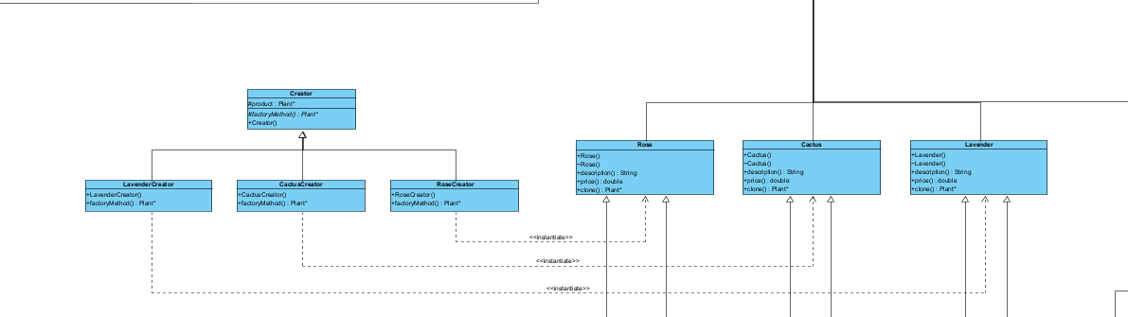
Command
Factory Method

Slide 14
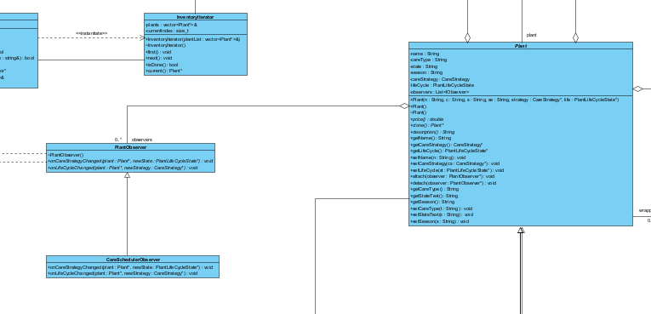
Observer

Slide 15
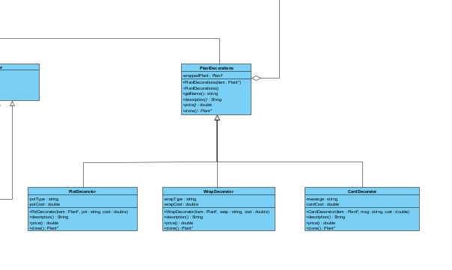
Command
Decorator

Slide 16
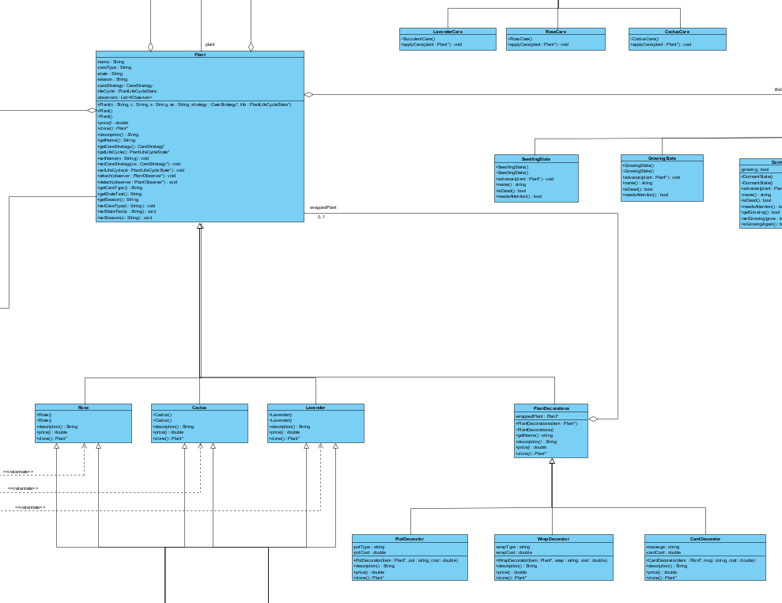
Command
Prototype

Slide 17
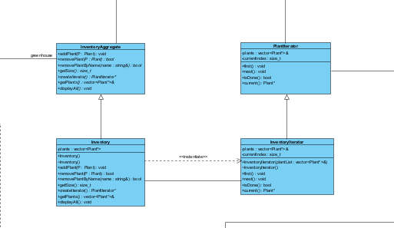
Iterator

Slide 18
Adapter (STILL NED TO DO)

Slide 19
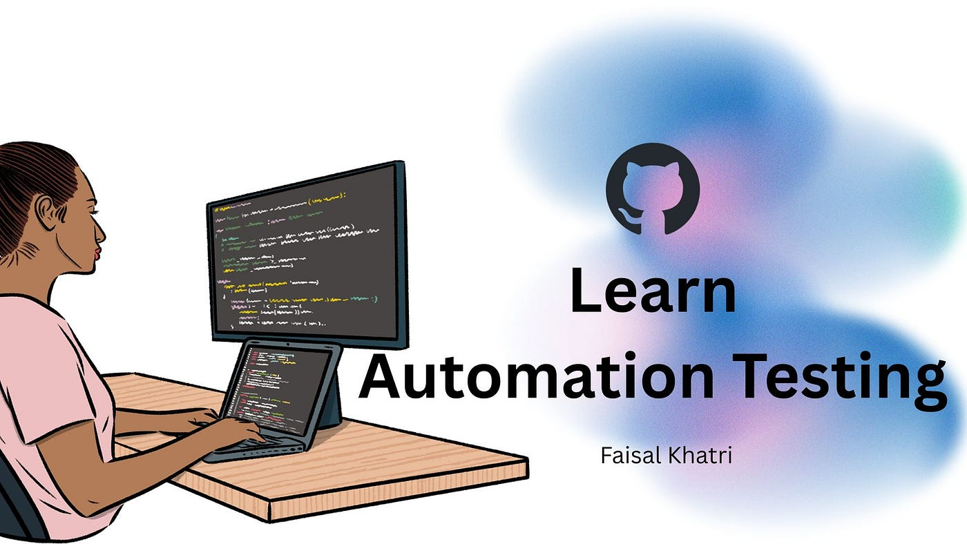
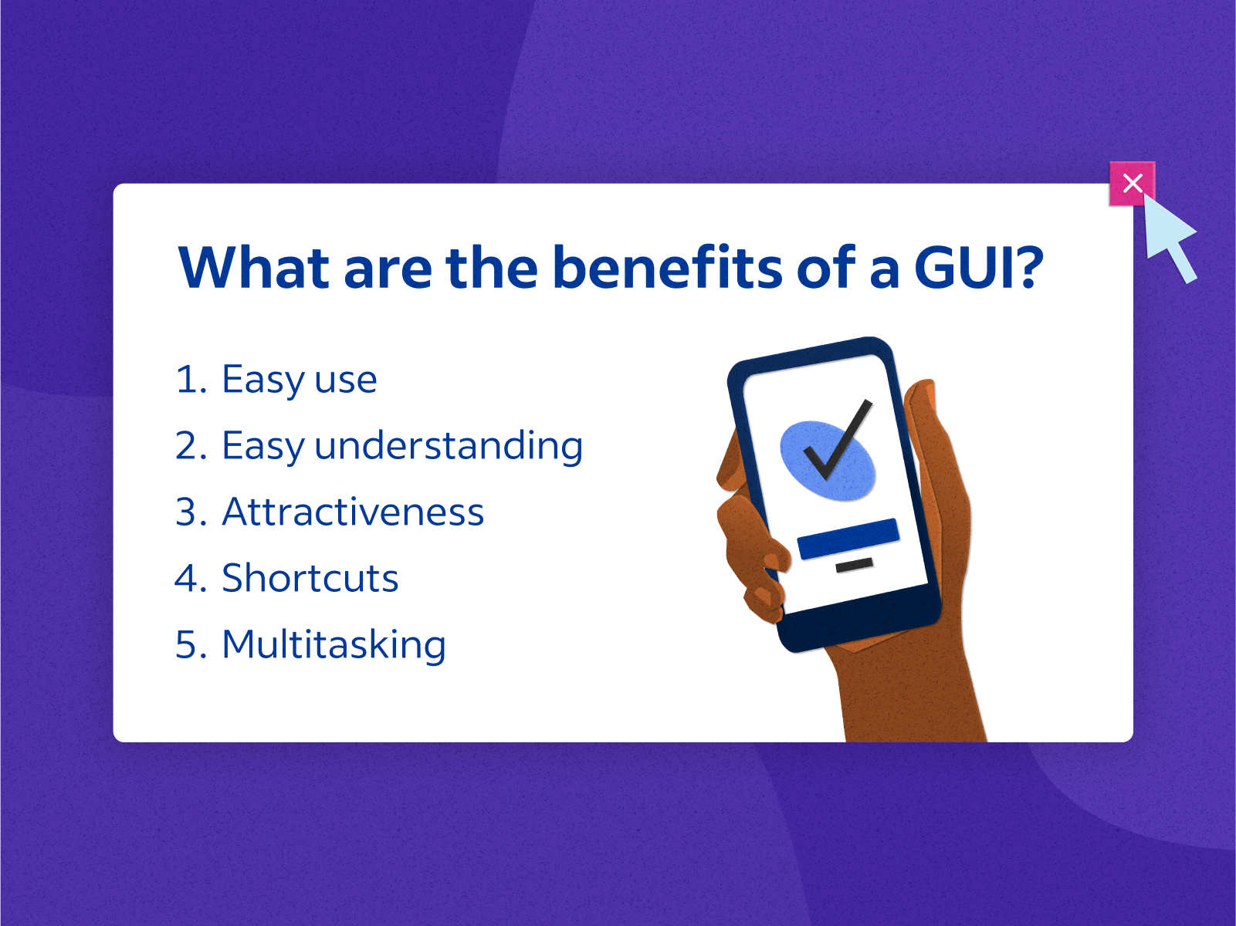
Bonus Marks
Created a simple GUI (will be shown in the presentation)
Implemented GitHub Actions for automated linting and testing

Slide 20
Version Control with Git
We used a secondary testing main before merging to main
1
Each member developed their own design pattern independently
2
All patterns were merged into the secondary main for testing together
3
When patterns were linked, all team members reviewed and added comments where needed
4
We fixed issues and improved code before final merging
5
Merge conflicts were resolved collaboratively
6

Slide 21

Unit testing
Not sure what to Add
Add
Add
Add
Add

Slide 22

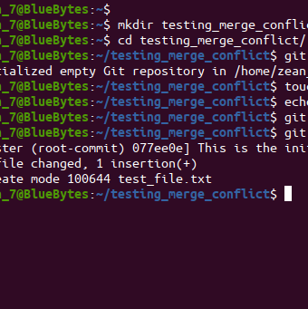
Conflict
Say we had no conflict and we meet regular to see what had to be done every Monday we meet and discussed on the whatsapp group what we had to do but overall all the works was distrubted evenly and majority of the meeting was to just sort merge conflict

Slide 23

Demo time

Slide 24
Thank you
Thank you and hope you enjoyed our demo
Any Question

